Slide 1
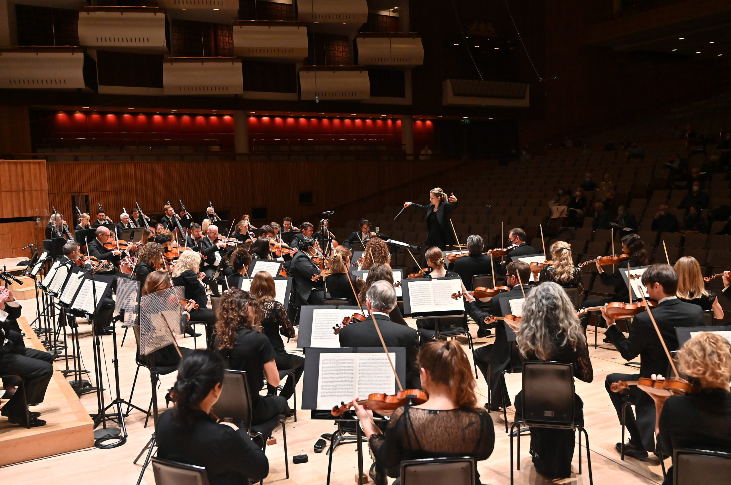
GCSE BrightSparks
Resources
BrightSparks is generously funded by the Rothschild Foundation with additional support from the Candide Trust, Dunard Fund, Rivers Foundation, The R K Charitable Trust, Mr & Mrs Philip Kan, Gill and Julian Simmonds
© Rachel Leach and the London Philharmonic Orchestra 2022

Slide 2
John Williams
(b. 1932)
Superman March
(1978)

Slide 3
John Williams
(b. 1932)
American film composer
Famous for symphonic scores with leitmotifs
Leitmotif = small music idea that represents a place, character, emotion, theme etc within the film’s story

Slide 4
Williams – Superman March – 1978
Analysis

Slide 5
Williams – Superman March – 1978
Theme A: includes Superman motif
Long, low pedal note/drone
Fanfare figure (brass) with 3 notes – C, G, C
Pedal = long, often low pitch that underpins the harmony
Drone = one long note, continuously sounded

Slide 6
Williams – Superman March – 1978
Theme A: Includes Superman motif
Rhythmic ostinato from lower strings, lower woodwind, bass trombone and tuba…
…acting as a pedal
Ostinato = repeating pattern

Slide 7
Williams – Superman March – 1978
Theme A: Includes Superman motif
Pedal shifts from C to F to G
Briefly homorhythmic – everyone plays the same rhythm at the same time

Slide 8
Williams – Superman March – 1978
Theme B
Main marching theme
Uses the tonic, the fourth below and the fifth above
Spiky fanfare rhythm
Each phrase begins with an anacrusis
Anacrusis = phrase starts on the upbeat

Slide 9
Williams – Superman March – 1978
Theme B
Accompaniment features fragments of ostinato
Cymbals, triangles, tremolandos and scales decorate
Followed by transitional theme from the cellos
Theme B repeats (bigger and bolder)

Slide 10
Williams – Superman March – 1978
Theme C: associated with love and Lois Lane
In F (we’ve modulated to the subdominant)
Legato (smooth)
Accompanied by the ostinato in the strings
Scales decorate (woodwind, piano, harp)

Slide 11
Williams – Superman March – 1978
Theme C: associated with love and Lois Lane
Sequence on woodwind
Sequence = musical material repeated at a higher or lower pitch

Slide 12
Williams – Superman March – 1978
Key shifts to Bb
Repeat of marching Theme B
Return to Theme A in two different keys

Slide 13
Williams – Superman March – 1978
Coda (ending)
Chromatic movement from the brass
Ostinato acting as a tonic pedal (on G)
Progressive tonality – ends in G (different key from the beginning)

Slide 14
Williams – Superman March – 1978
Quiz Questions
Which instruments start playing at bar 5?
What is the term for a repeating pattern?
At bar 16 everyone has the same rhythm. What is the term for this?
What four percussion instruments can you hear from bars 27 to 33?
What’s the technical term for beginning on the upbeat?
Which brass instruments play the transitional melody at bar 43?
Who plays the repeating pattern at bar 67?
At bar 77 the woodwind repeat the material on a higher starting pitch. What’s the term for this?
What’s happening in the brass at bar 87?
What theme is played at bar 97?

Slide 15
Williams – Superman March – 1978
Answers
Lower brass
Ostinato
Homorhythmic
Cymbal crashes, triangle rolls, glockenspiel on the tune, timpani underpins the harmony
Anacrusis
Horns
Strings
Sequence
Falling 4-note ostinato
A (fanfare)

Slide 16
For more information about concerts, education projects, resources and recordings, visit
lpo.org.uk
BrightSparks is generously funded by the Rothschild Foundation with additional support from the Candide Trust, Dunard Fund, Rivers Foundation, The R K Charitable Trust, Mr & Mrs Philip Kan, Gill and Julian Simmonds
© Rachel Leach and the London Philharmonic Orchestra 2022

